Slide 1
0x401 – SW Reverse Engineering Basics
ECED4406 – Computer Security
Dr. Colin O’Flynn
Dalhousie University.

Slide 2
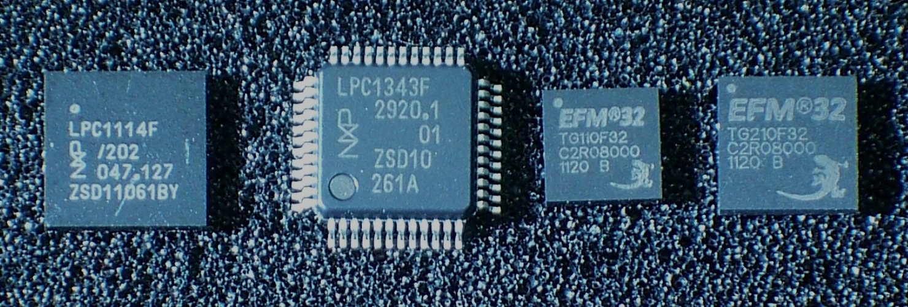
Software Reverse Engineering
Software reverse engineering is common requirement as part of security research.
We will focus in particular on Arm Cortex-m language reverse engineering.
https://en.wikipedia.org/wiki/ARM_Cortex-M#/media/File:ARM_Cortex-M0_and_M3_ICs_in_SMD_Packages.jpg

Slide 3
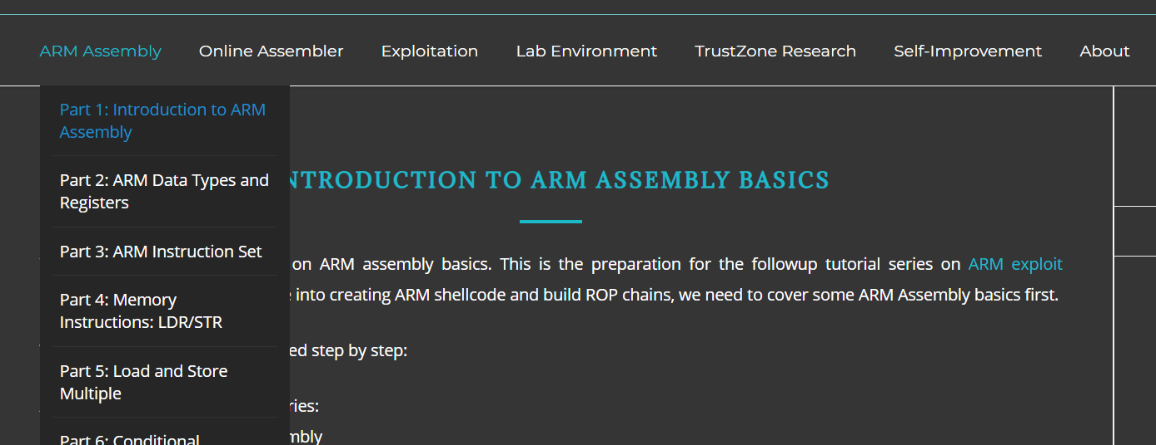
Resources for Arm Reverse Engineering
Recommended resource for more in depth - Azeria Labs -
https://azeria-labs.com/writing-arm-assembly-part-1/

Slide 4
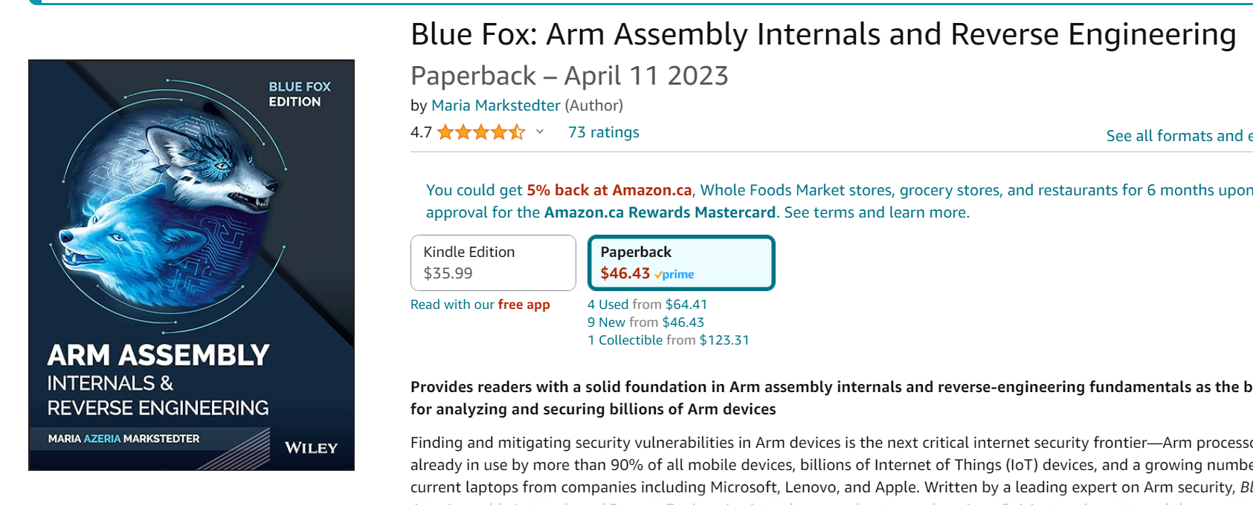
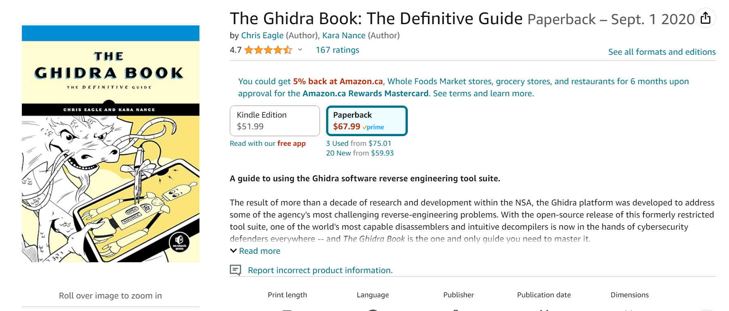
Books for Reverse Engineering (Going Deeper)

Slide 5
What we are going to cover in this section:
What is reverse engineering
Examples of C → Assembly
Exploring Function Calls
Looking at a few example binaries
…There is a *lot* more you can do with this ☺

Slide 6
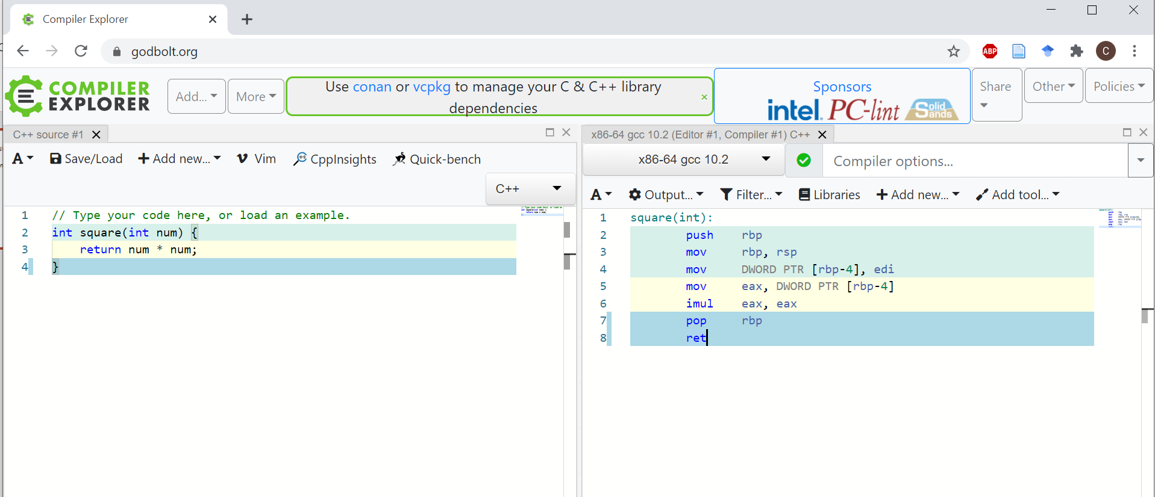
Using Compiler Explorer
Available online at Godbolt.org (made by Matt Godbolt)

Slide 7
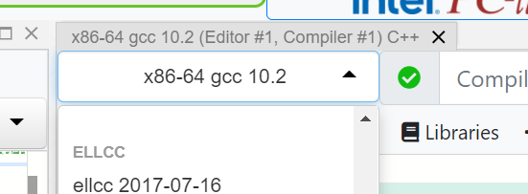
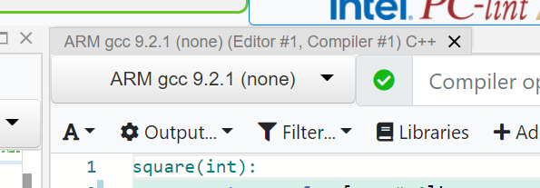
Set the compiler type

Slide 8
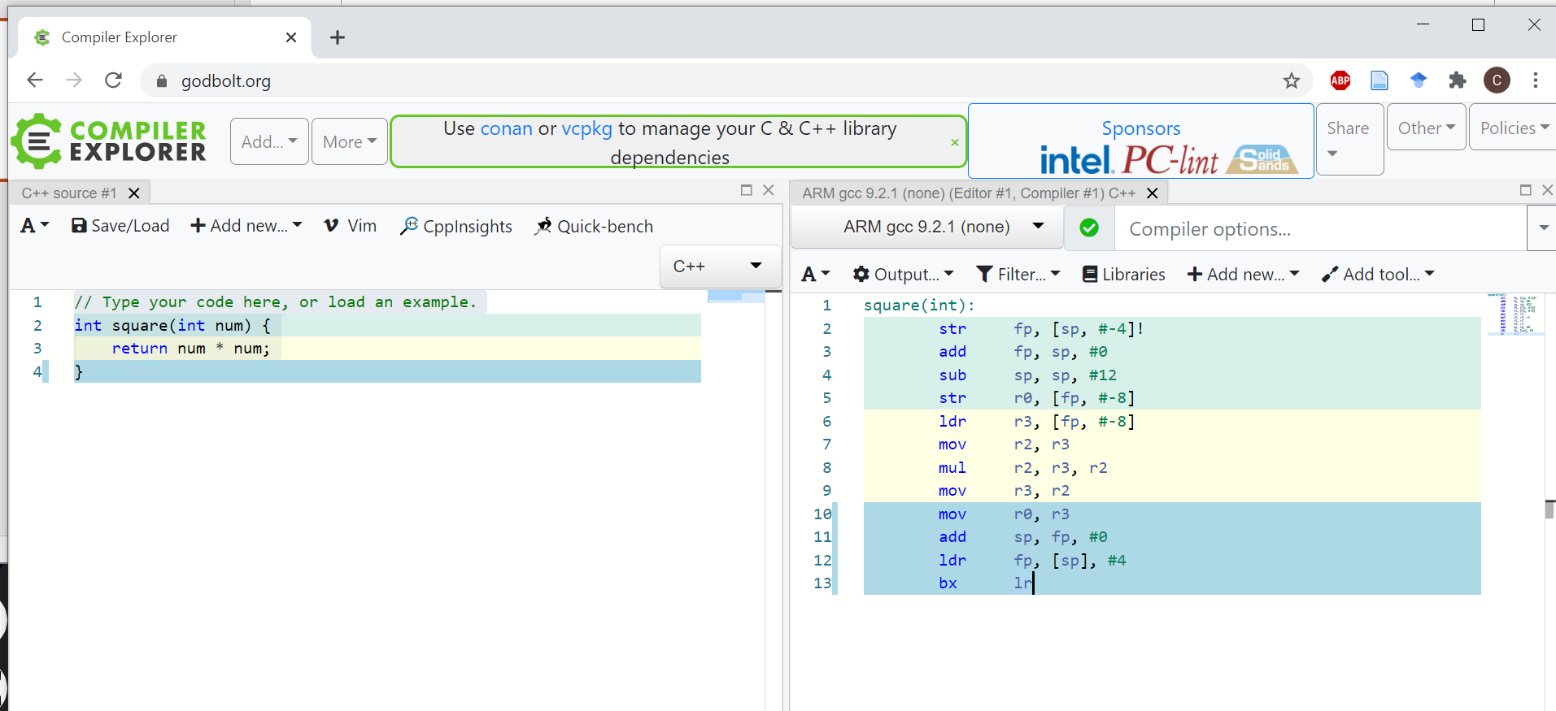
Default Example Code

Slide 9
How does it work?
Compiles C code on left to ASM on right.
Applies optimizations – if your code does nothing it may get optimized away (just like in real life).
You can call external functions, the assembly for them won’t show up.

Slide 10
Try the following codes:
A “for” loop
Addition operations
Multiply operations
Calling other functions

Slide 11
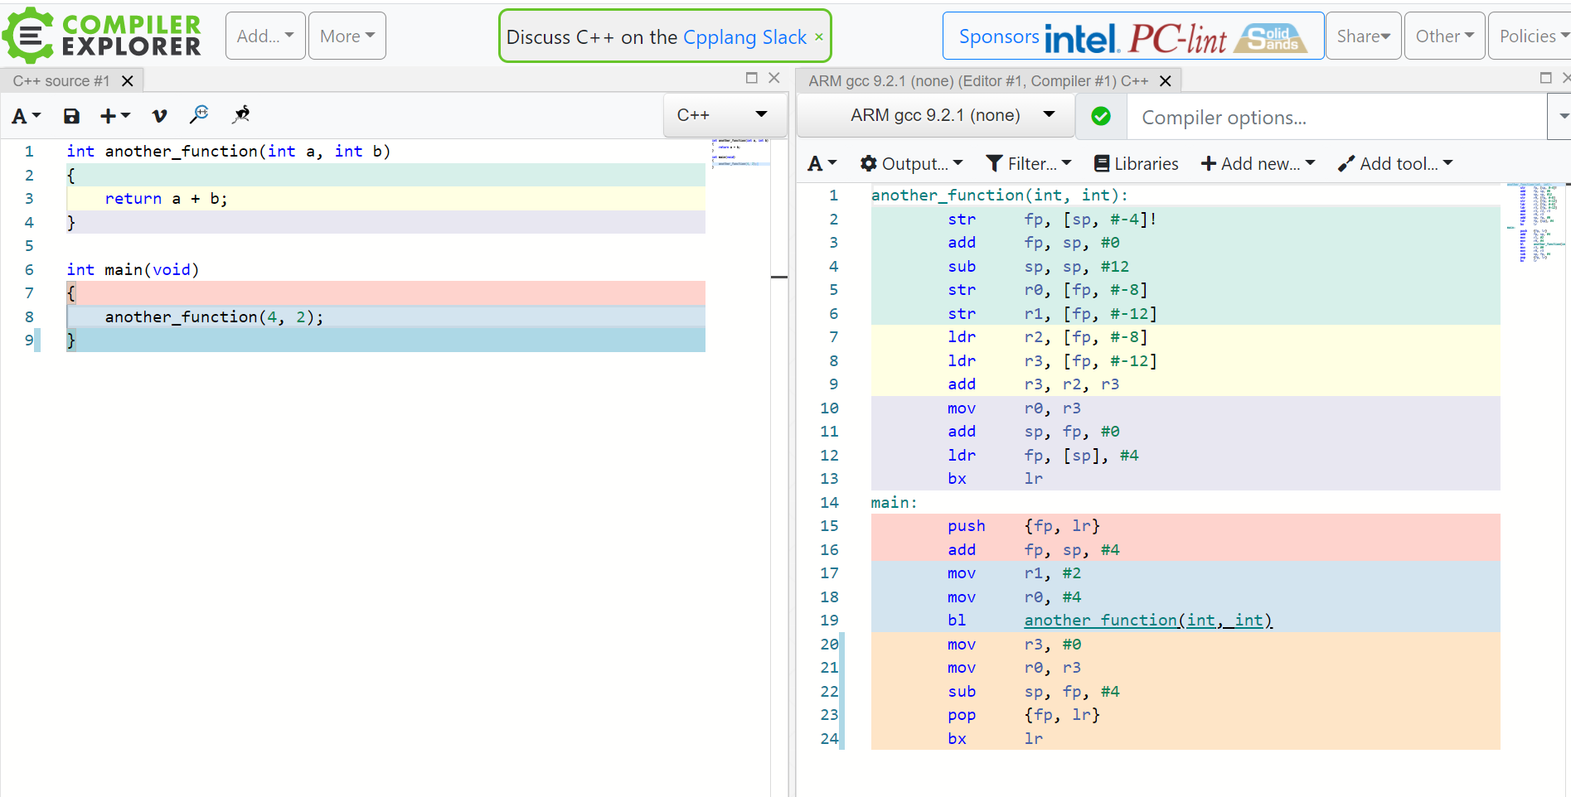
Example: Calling other functions

Slide 12
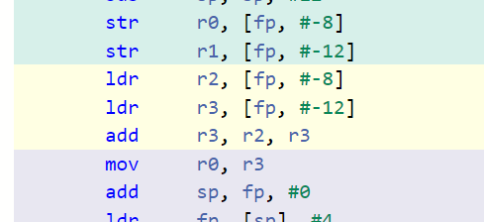
Questions for Quiz – use Compiler Explorer to answer the following…
What is the assembly instruction for addition of numbers?
When calling a C function, where does:
The first argument go?
The second argument go?
When does it stop using this method?

Slide 13
Hint – to see how arguments are stored
int another_function(int a, int b, int c, int d, int e, int f, int g)
{
return a + b;
}
int main(void)
{
another_function(4, 2, 5, 6, 2, 4, 2);
}

Slide 14
Function Calls
Calling convention is how various function calls pass arguments.
Calling conventions vary for architectures & compilers.
Can find calling convention information (normally) in compiler documentation.
Functions themselves will normally do setup (prologue) & teardown (epilogue)

Slide 15
Example: avr-gcc calling convention
Function call conventions:
Arguments - allocated left to right, r25 to r8.
All arguments are aligned to start in even-numbered registers (odd-sized arguments, including char, have one free register above them). This allows making better use of the movw instruction on the enhanced core.
If too many, those that don't fit are passed on the stack.
Return values:
8-bit in r24 (not r25!)
16-bit in r25:r24
up to 32 bits in r22-r25
up to 64 bits in r18-r25
8-bit return values are zero/sign-extended to 16 bits by the called function (unsigned char is more efficient than signed char - just clr r25).
Arguments to functions with variable argument lists (printf etc.) are all passed on stack, and char is extended to int.
https://www.nongnu.org/avr-libc/user-manual/FAQ.html

Slide 16
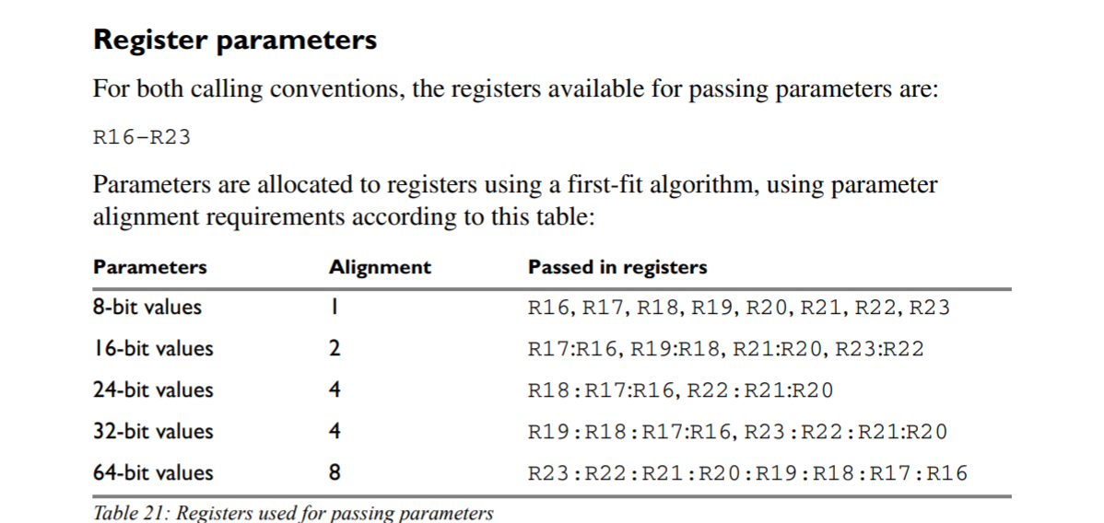
Example IAR avr calling convention
Recognizing calling conventions
http://ftp.indes.com/pub/mirrors/ftp.iar.se/WWWfiles/avr/webic/doc/EWAVR_CompilerGuide.pdf
Flip to page 159

Slide 17
Calling Convention – Different Compilers
Calling convention of the two compilers is different, even with same target (AVR in this case).
Recognizing calling conventions important for reverse engineering.

Slide 18
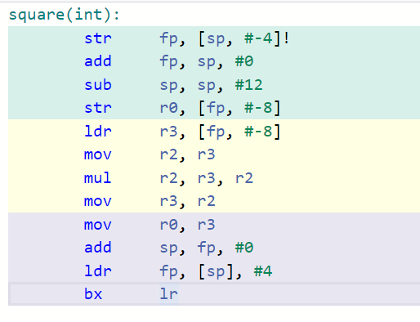
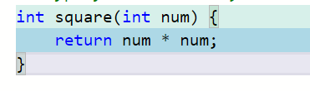
Recognizing function calls
We can see call to function.
We normally see return at end of function.
..What about in between?
return

Slide 19
Function Calls
Much of this deals around the usage of the stack – this should have been covered in your computer architecture classes and this is just a refresher.
If you need a refresher: https://azeria-labs.com/functions-and-the-stack-part-7/

Slide 20
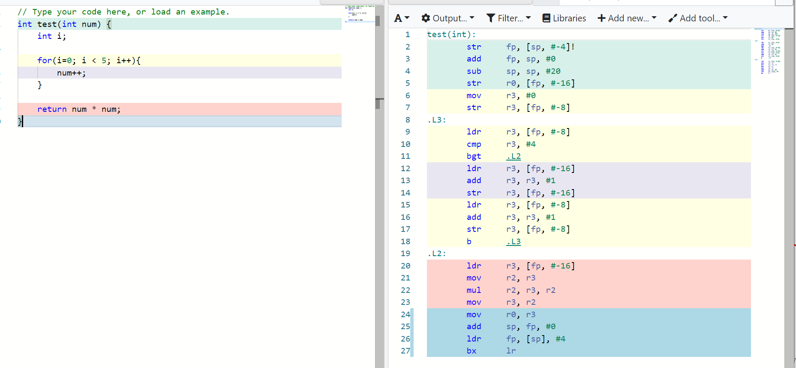
Example of Local Variables

Slide 21
Where do local variables get stored?
Often stored in registers.
May also be stored in memory (RAM), normally when:
Compiler has run out of registers to use.
Variable is declared static (stays around).
Variable is declared volatile.
Compiler feels like it (optimization disabled, other reasons).

Slide 22
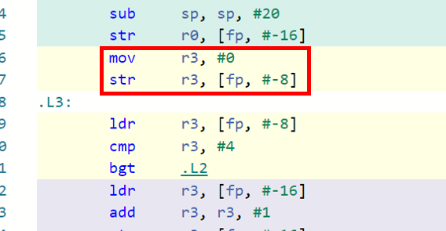
Registers vs. Memory?
The CPU can only perform operations (such as comparisons, additions, etc) on registers.
Therefor all variables will get moved from memory into registers when used.
Set r3 to 0, then store to address [fp, #-8]
Load from address [fp, #-8] into r3

Slide 23
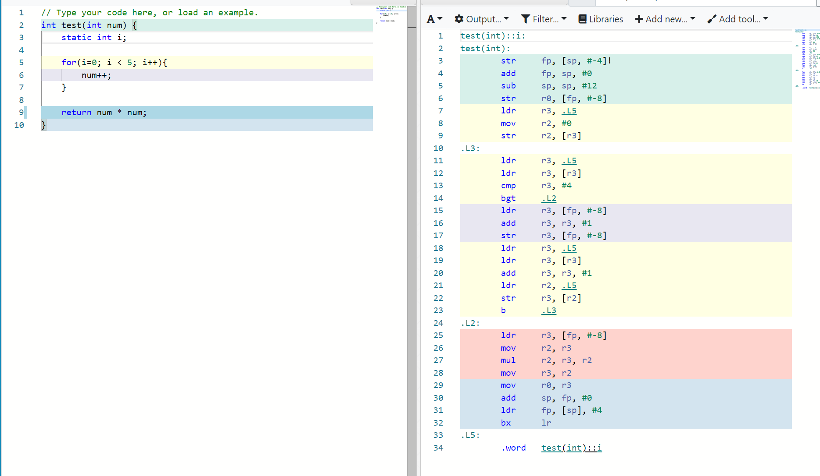
Stack vs. Static
Define variable static -> now stored at some specific location.

Slide 24
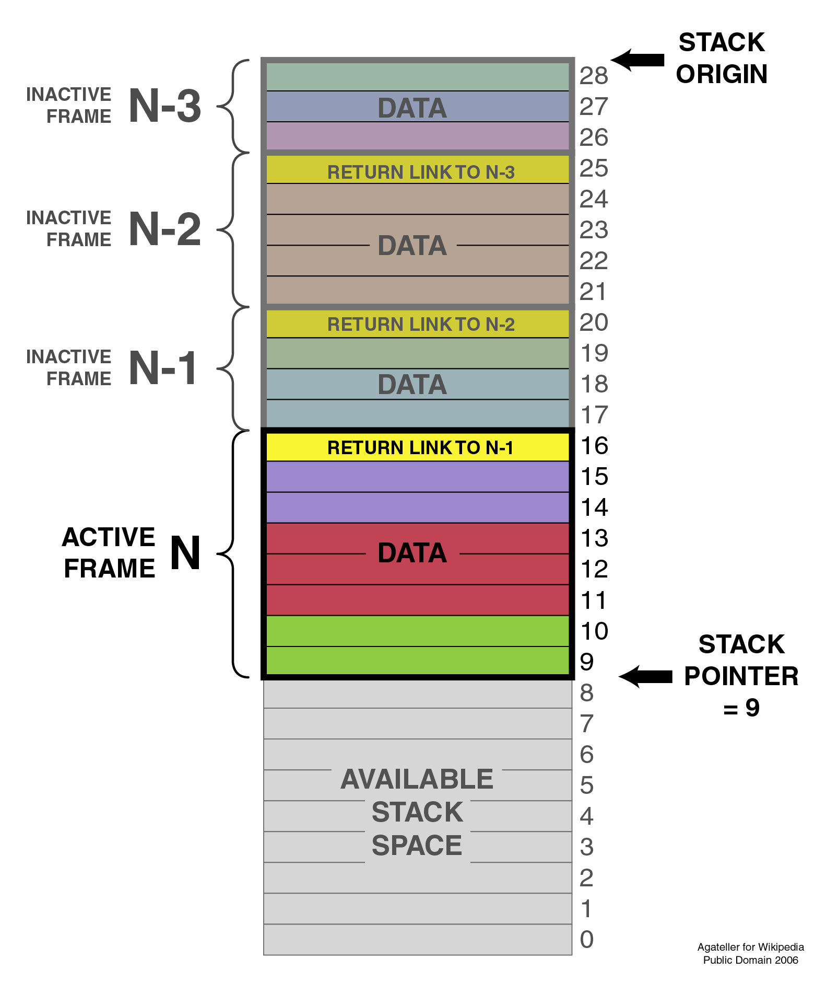
What was this [fp, #-8] thingy?
fp = “Frame Pointer”

Slide 25
Variables in Functions
CPU only functions on registers.
When tracking where in memory things are stored – may need to look back a little to see if load/store happens.
Local variables are stored on the stack frame – this will be reused in other functions.
Global or static variables are stored at a specific location in memory (and never re-used).

Slide 26
Summary – SW Reversing
These slides should have been mostly a refresher on computer architecture topics.
We’ll use Compiler Explorer to observe how C/ASM mapping works (later we need to do the reverse, where we only have ASM).
Next we’ll explore what a “binary” exactly consists of…

